Slide 1
Python tips and tricks
Guan Wang

Slide 2

List Comprehension
List comprehension
Basic syntax of a list comprehension:
expression: This is the operation to perform on each item. It can be a mathematical operation, a function call, etc.
item: The variable representing each element in the iterable.
Iterable: A sequence (list, tuple, etc.) or collection (set, dictionary, etc.) that you want to loop over.
condition (optional): A filter that only includes the elements where the condition is true.

Slide 3
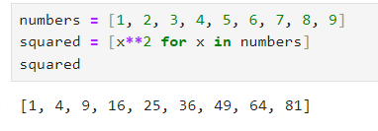
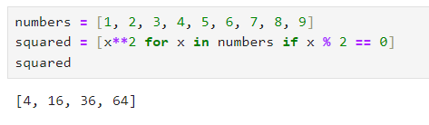
List Comprehension

Slide 4
List Comprehension
Conciseness: Reduces the lines of code while maintaining readability.
Performance: Often faster than equivalent operations performed with a for-loop or map().
Expressiveness: Allows you to clearly express the transformation and filtering in a single line.
Notes:
List comprehensions are a powerful tool in Python, making your code more readable, expressive, and often faster. They are particularly useful in data handling, where you need to perform operations on each element of a large dataset efficiently.

Slide 5
Dictionary Comprehensions
key_expression: The key for the corresponding value
value_expression: The corresponding value of the key
item: The variable representing each element in the iterable
iterable: A sequence (list, tuple, etc.) or collection (set, dictionary, etc.) that you want to loop over.
condition (optional): A filter that only includes the elements where the condition is true.

Slide 6
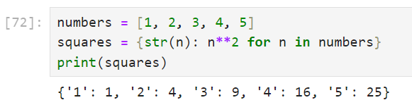
Dictionary Comprehensions
Creating a dictionary from a list

Slide 7
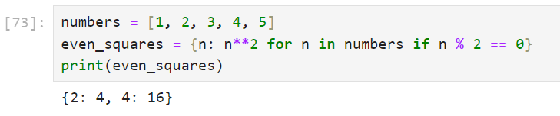
Dictionary Comprehensions
Creating a dictionary from a list with a condition

Slide 8
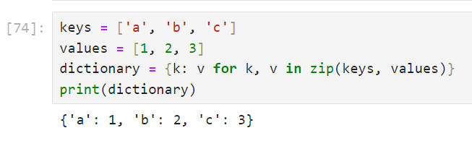
Dictionary Comprehensions
Transforming Lists into a Dictionary

Slide 9
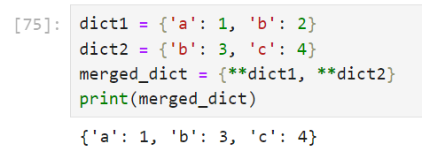
Dictionary Comprehensions
Merging Dictionaries with the Double Asterisk (**)
The double asterisk (**) is used to unpack the contents of a dictionary into a new dictionary.

Slide 10
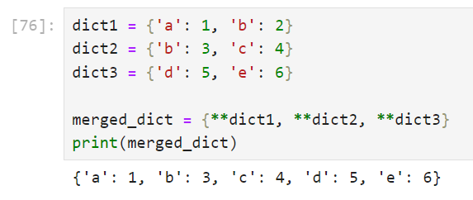
Dictionary Comprehensions
Merging multiple dictionaries

Slide 11
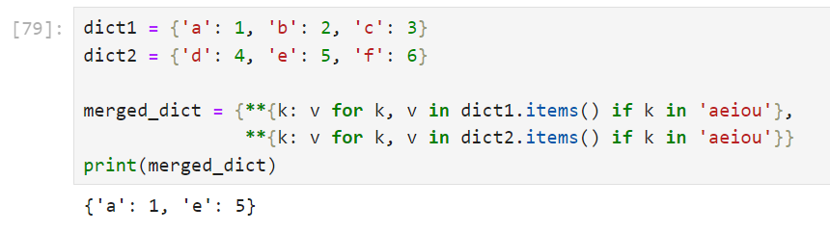
Dictionary Comprehensions
Conditional Merging: Merge with a condition, e.g., only keys that are vowels

Slide 12
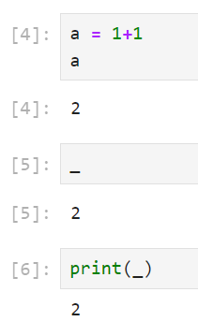
Underscore (_)
Last Expression in Python

Slide 13
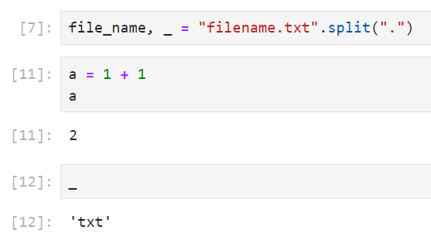
Underscore (_)
Last Expression in Python
Ignoring Values

Slide 14
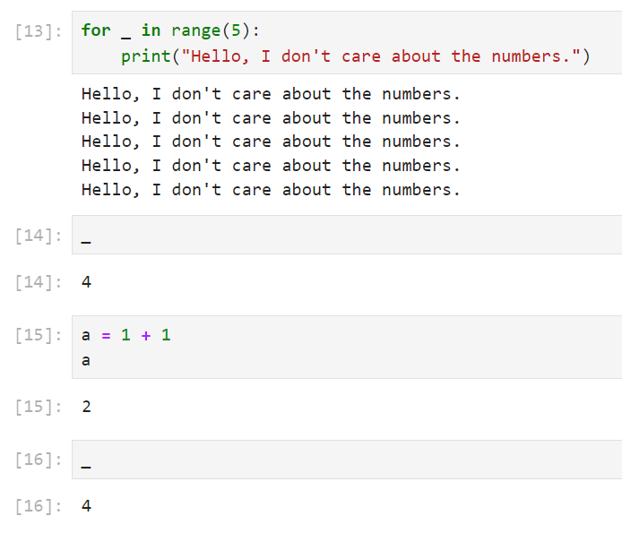
Underscore (_)
Last Expression in Python
Ignoring Values
As a loop Variable

Slide 15
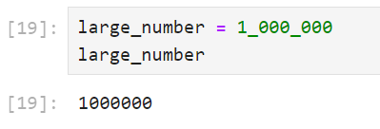
Underscore (_)
Last Expression in Python
Ignoring Values
As a loop Variable
Formatting Large Numbers

Slide 16
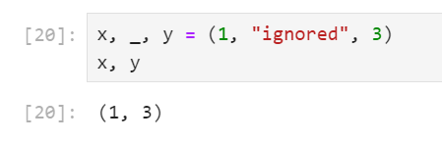
Underscore (_)
Last Expression in Python
Ignoring Values
As a loop Variable
Formatting Large Numbers
Placeholder for temporary or unimportant variables

Slide 17
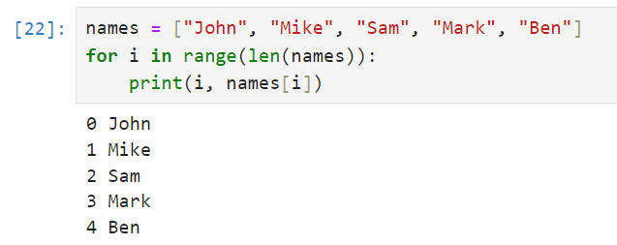
Use enumerate() for more pythonic looping
Notes:
When iterating over sequences in Python, it’s common to need both the index and the value of each item. While the traditional method might involve using range() and len(),

Slide 18
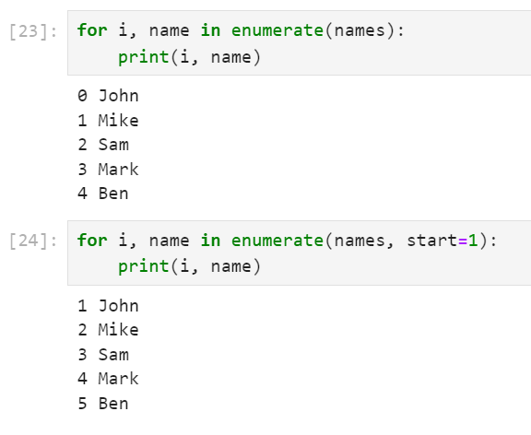
Use enumerate() for more pythonic looping

Slide 19

The zip() function in Python
The zip() function takes iterables as input, such as lists or tuples, and returns an iterator of tuples.
Each tuple contains elements from the corresponding position in each of the input iterables.
The iteration stops when the shortest input iterable is exhausted, meaning that zip aligns with the length of the shortest iterable.

Slide 20
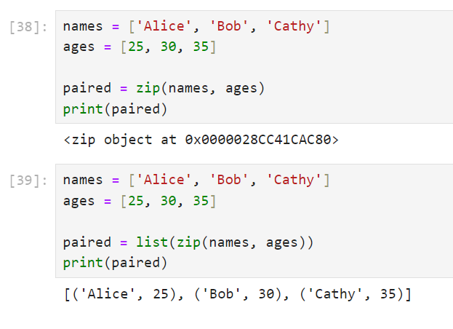
The zip() function in Python

Slide 21
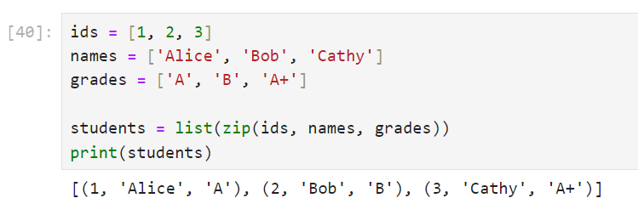
The zip() function in Python
Multiple iterables

Slide 22
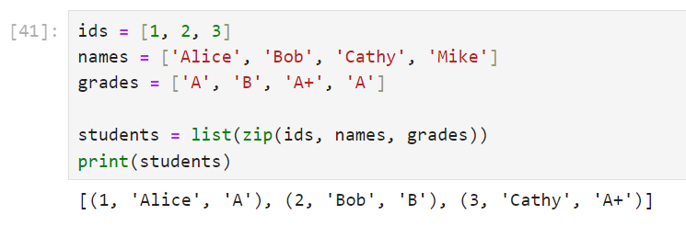
The zip() function in Python
aligns with the length of the shortest iterable

Slide 23
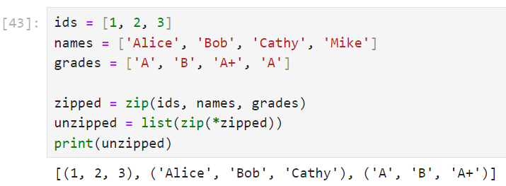
The zip() function in Python
We can also “unzip” values using zip together with the asterisk operator (*), which unpacks the aggregated data:
Notes:
This technique is handy for re-creating the original lists from a list of tuples.

Slide 24

Small and anonymous function: lambda
lambda is a minimal function definition that can be used inside an expression
arguments: the parameter list, it could be a list of 0 or more parameters
expression: is the body of this function where the parameters are delt with and then return the result.

Slide 25
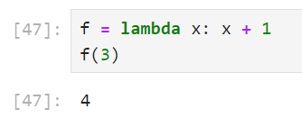
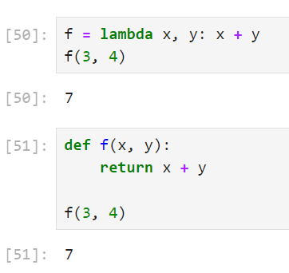
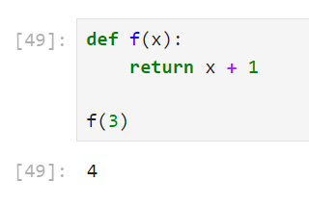
Small and anonymous function: lambda

Slide 26
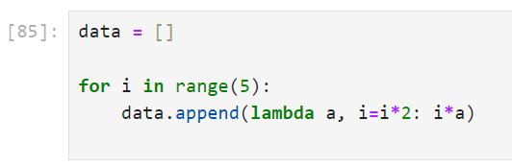
Small and anonymous function: lambda

Slide 27
Small and anonymous function: lambda

Slide 28
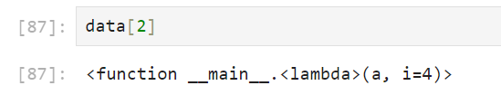
Small and anonymous function: lambda

Slide 29
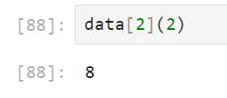
Small and anonymous function: lambda

Slide 30

sorted() function
Similar to list.sort(), but is not an in-place function
Works on any iterable and returns a new sorted list from the elements of any iterable
Parameters
iterable: The sequence of elements to be sorted
key: A function that serves as a key for the sort comparison
reverse: A Boolean value. If set to True, the iterable is sorted in descending order.

Slide 31
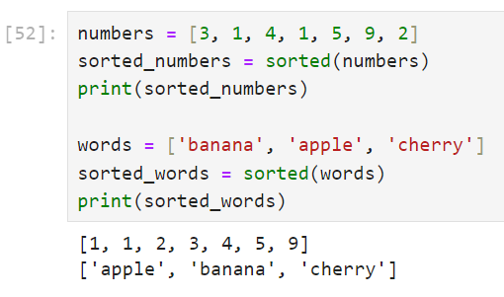
sorted() function
The simple use case is sorting numbers and strings

Slide 32
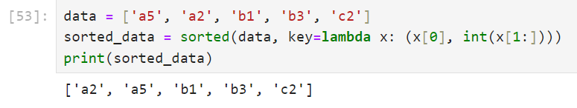
sorted() function
Sorting with custom Keys

Slide 33
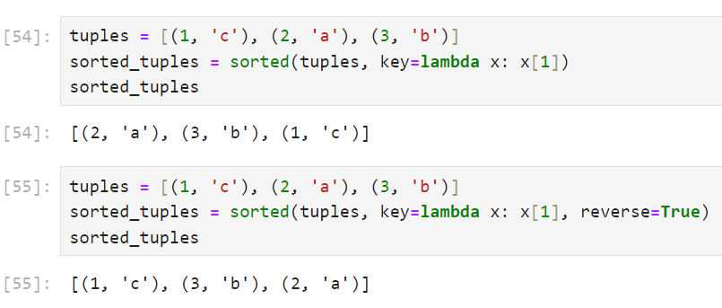
sorted() function
Sorting tuples by specific element

Slide 34
Save Memory with Generators in Python
Generators provide a way to write functions that can send back a value and later resume to pick up where they left off
Generators produce items only one at a time, on demand, which leads to reduced memory usage compared to other collection objects like lists or tuples that store all elements at once
This makes generators particularly useful for working with large datasets or streams of data where only one element is needed at a time

Slide 35
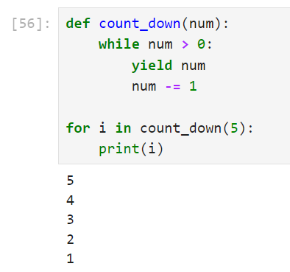
Save Memory with Generators in Python
Generator function
Each call to the generator’s __next__() method fetches the next value from yield, making it memory-efficient for large ranges.
Notes:
Each call to the generator’s __next__() method fetches the next value from yield, making it memory-efficient for large ranges.

Slide 36
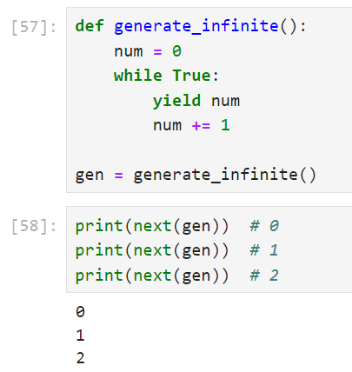
Save Memory with Generators in Python
Generator function
Generating infinite sequences
You can keep calling next() without worrying about running out of memory.

Slide 37
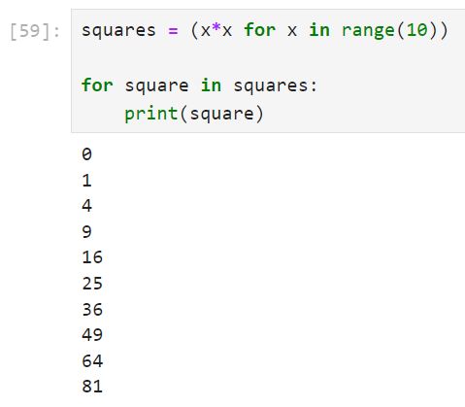
Save Memory with Generators in Python
Generator function
Generator expressions

Slide 38
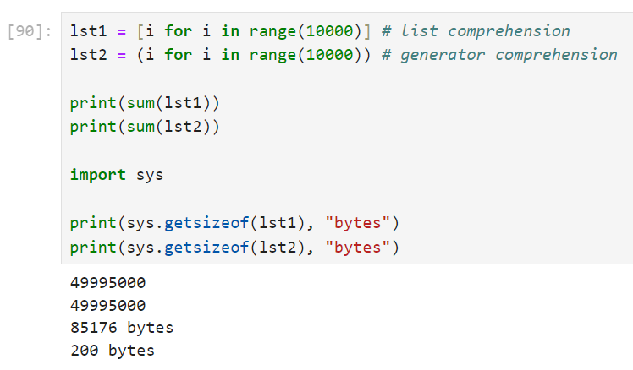
Save Memory with Generators in Python

Slide 39
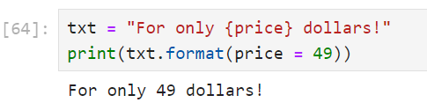
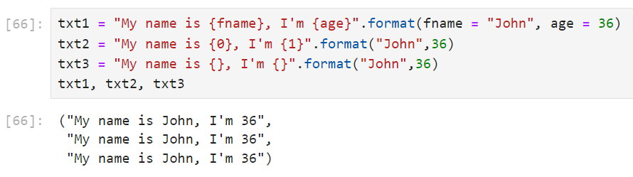
Formatting Strings with f-Strings in Python
string.format() with placeholders

Slide 40
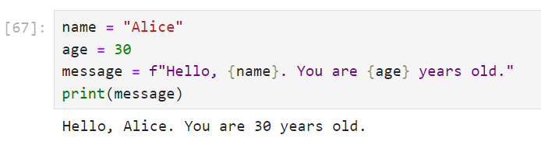
Formatting Strings with f-Strings in Python
f-strings

Slide 41
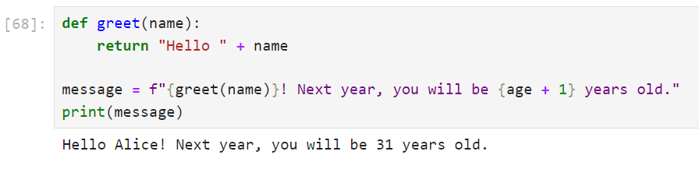
Formatting Strings with f-Strings in Python
f-strings

Slide 42
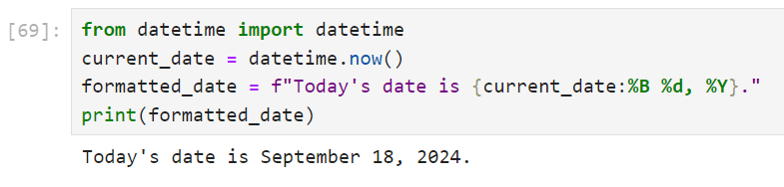
Formatting Strings with f-Strings in Python
Date Formatting

